Slide 1

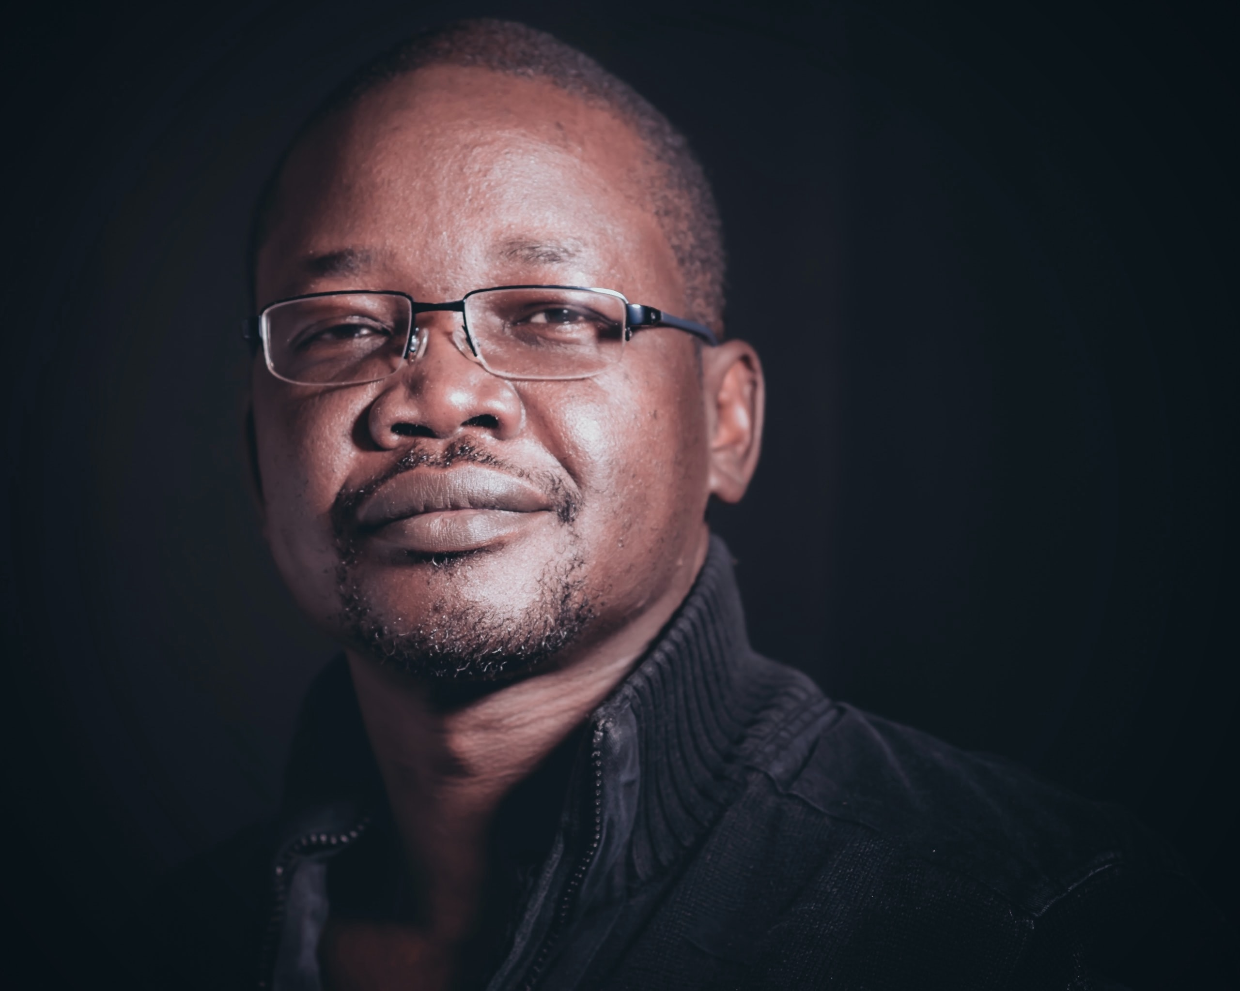
Challenges
Goals
Solutions
With COVID – 19 there has been an increase in POs caseloads - keeping up with the influx is tough because they aren’t able to spend as much time rehabilitating the participants as they would like to.
Foster long term change in participants and allowing them to get more out of their time on probation vs. just monitoring their actions.
We provide a software solution with robust reporting to ensure that John is able to utilize the tools to generate the data needed to apply for grants and justify his decisions to the board.
Find an all-in one solution that can help his probation officers save time and manage their caseload in the office and on the go.
Software that is easy to use and has an amazing customer support team to ensure that by implementing the new solution his Probation Officers can save time with the day-to-day tasks.
The excessive amount of paperwork daily.
Managing the budget and justifying decisions to the board.
Ensuring his probation officers are set up for success so the participants have the attention they need and work doesn’t overflow to him.
Cutting through all the red tape to make the best decisions for his department.
Software that automates activities such as form response collection and location monitoring ensuring that the POs have less work and get to spend more time with their participants.
Find a solution that is affordable, efficient and provides him with the statistics and reporting he needs to apply for grants and justify his decisions to the board.
John Jacob
Chief Probation Officer
“
Motivations
Technology
AGE
COURT
EDUCATION
LOCATION
43
Probation
Masters in Criminal Justice
New Hampshire
I would love to find an all-in-one solution for my Probation Officers to use that would automate tasks, provide reporting, and collect data so they can spend more time helping the participants and I can spend less time compiling data to apply for funding.
PRICE
Desktop
EASE OF SET UP
Smartphone
EASE OF USE
iNTERNET
Professional
likeable
QUALITY OF SUPPORT
software
passionate
organized

Slide 2
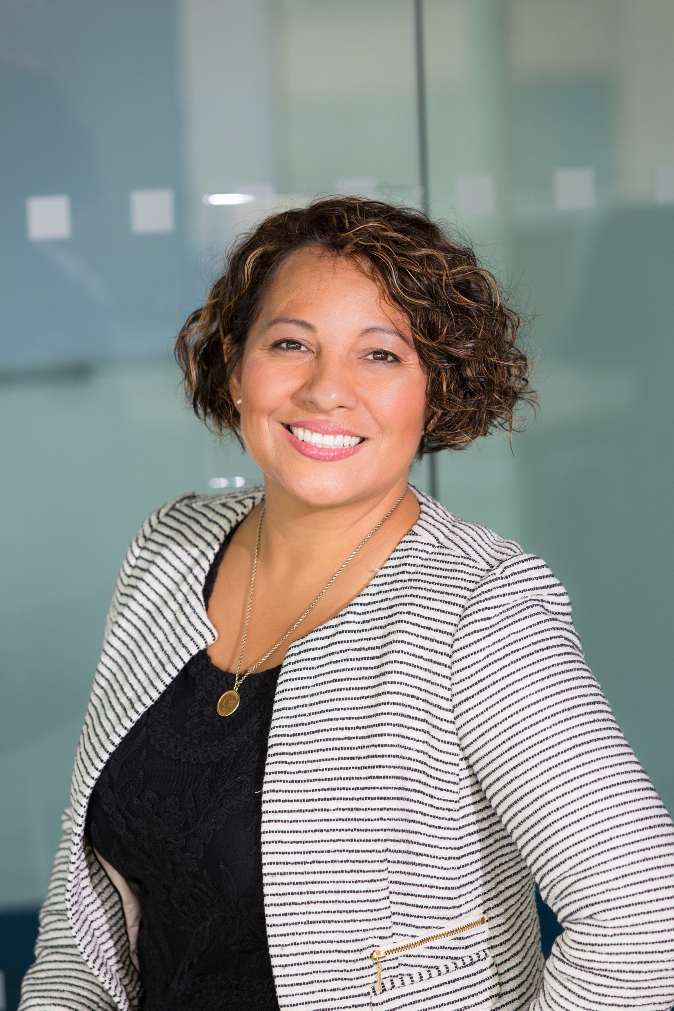
Challenges
Needs
Solutions
Monitoring the number of participants in our district.
Way of randomizing and scheduling drug tests.
A software solution that allows for scheduling tests for participants that need extra check-ins and incentivizing the participants that are performing well during their drug court duties.
Making sure that participants are checking in regularly.
A platform that allows for fully fleshed out violation reports with all information required to present to a judge.
Ensuring participants are staying away from places they shouldn’t be that may hinder their recovery.
A dependable platform to monitor participants through 24/7 location tracking.
Easy set up and use to ensure seamless transfer to new platform.
A responsive platform that can operate on both mobile and desktop keeping case managers connected to participants.
A platform that connects probation officers and case managers with participants remotely.
Ashley Jackson
Court Director
“
Motivations
Technology
AGE
COURT
EDUCATION
LOCATION
35
Drug Court
Bachelors Degree
San Diego, CA
We are searching for an all-in-one platform that will allow us to customize our treatment plan based on how the participant is performing. The ability to monitor our participants remotely 24/7 on desktop and mobile is essential.
PRICE
Desktop
EASE OF SET UP
Smartphone
EASE OF USE
iNTERNET
Empathetic
Resilient
QUALITY OF SUPPORT
software
Logical
Adaptable

Slide 3
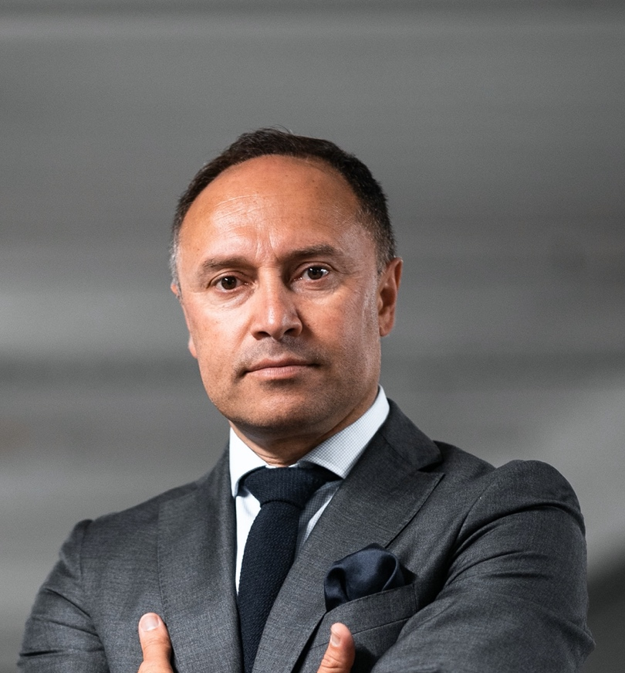
Challenges
Needs
Solutions
Ensuring participants are remaining sober throughout the program.
An affordable-robust solution to manage participants.
Completely customizable drug and alcohol testing schedules.
Participants are attending all scheduled treatment sessions, court dates and social support groups.
A way to schedule and randomize drug and alcohol testing.
Ability to export organized robust reports to present to a judge.
A solution for curfew check-ins.
Remote check-ins to ensure the participants are staying on track.
Keeping the program running despite reduced funding.
A way to incentivize participants that remain in compliance with the program.
Responsive and helpful customer support system.
Jeremy Thomas
Court Director
“
Motivations
Technology
AGE
COURT
EDUCATION
LOCATION
46
Sobriety
Bachelors Degree
Tampa, FL
We are searching for an all-in-one management solution within our budget that will help us keep our participants on the right track. Our program strives to keep the participants healthy while reducing recidivism.
PRICE
Desktop
EASE OF SET UP
Smartphone
EASE OF USE
iNTERNET
Optimistic
Honest
QUALITY OF SUPPORT
software
Determined
Intelligent

